Slide 1




(22517)
Advanced Java Programming
Event Handling
12 Marks

Slide 2


Specific Objectives
To write event driven programs using the delegation event model.
To write programs using adapter classes & the inner classes.
2

Slide 3
The Delegation Event Model
Java adopts the so-called "Event-Driven" (or "Event-Delegation") programming model for event-handling
Provides standard mechanism for a source to generate an event and send it to a set of listeners
The listener simply waits until it receives an event.
Once received, the listener processes the event and then return.
The AWT's event-handling classes are kept in package java.awt.event.
3

Slide 4
There are mainly three parts in delegation event model:
- Event Source – the class from which events are generated when some change in the property of the component - Event Listeners – the classes which receive notifications of events - Event– defines the change in state in the event source class.

Slide 5
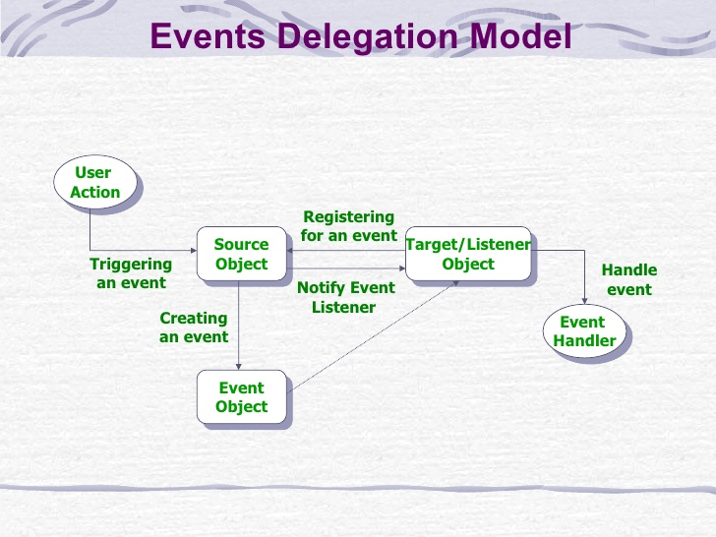

Slide 6
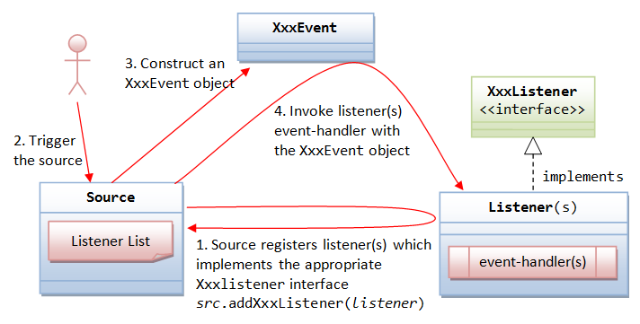

Slide 7
Event
Event is an object that describes a state change in a source.
Generated when user is interacted with components.
Example: Pressing Button, Selecting item from list etc.
It can be also generated when timer expires, counter value exceeds, software and hardware failure etc.
7

Slide 8
Event Source
Event Source is an object that generates an event.
This occurs when the internal state of that object changes.
Sources may generate more than one type of event.
Sources must register listener so that listener will receive notifications.
For Register/add:
public void addTypeListener(TypeListener el)
For remove:
public void removeTypeListener(TypeListener el)
8

Slide 9
Event Listener
Event Listener is an object that is notified when an event occurs.
When an event is fired, an event object is passed as an argument to the relevant listener object method. The listener object then handles the event.
Two requirements:
It must have been registered with one or more sources to receive notifications.
It must implement methods to receive and process these notifications.
9

Slide 10
Event Classes
Event Classes are core of Java’s event handling mechanism.
EventObject is the root of the Java event class hierarchy .
EventObject is present in java.util.
EventObject is the superclass for all events.
Constructor: EventObject(Object src).
EventObject class has defines two methods:
Object getSource( ) : method returns the source of the event.
String toString( ) : returns string equivalent of the event.
10

Slide 11
Event Classes : AWTEvent
AWTEvent is defined in java.awt package.
AWTEvent is a subclass of EventObject.
AWTEvent is the superclass of all AWT-based events.
getID( ) method can be used to determine the type of the event.
Syntax: int getID()
Summarize:
EventObject is a superclass of all events.
AWTEvent is a superclass of all AWT events that are
handled by the delegation event model.
11

Slide 12
To Summarize:
EventObject is a superclass of all events.
AWTEvent is a superclass of all AWT events that are handled by the delegation event model.
12

Slide 13
Summary
Event Source – Event Source is an object that generates an event.
Event Listeners – the interfaces which receive notifications of events
Listener is an object that is notified when an event occurs.
Event Object – the class object which describes the event.
Event is an object that describes a state change in a source
13

Slide 14
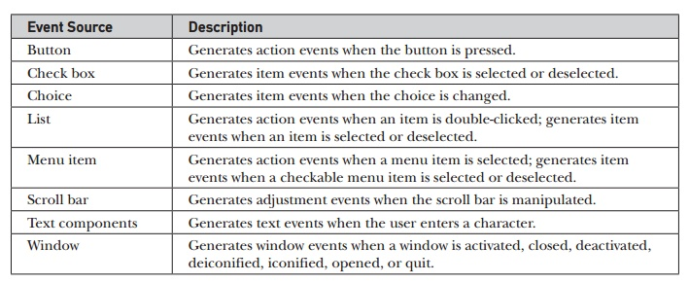

Slide 15
Event Classes : Different classes
ActionEvent
AdjustmentEvent
ComponentEvent
ContainerEvent
FocusEvent
ItemEvent
KeyEvent
MouseEvent
TextEvent
WindowEvent
15

Slide 16
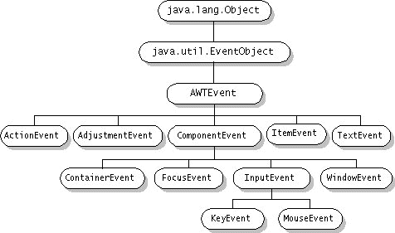
AWT event hierarchy

Slide 17
ActionEvent
Generated when a button is pressed, a list item is double-clicked, or a menu item is selected.
There is only one action event type, ACTION_PERFORMED
ActionEvent class defines four integer constants that can be used to identify any modifiers associated with an action event:
ALT_MASK, (8)
CTRL_MASK, (2)
META_MASK, (4)
SHIFT_MASK. (1)
11

Slide 18
ActionEvent
Constructors:
ActionEvent(Object src, int type, String cmd)
ActionEvent(Object src, int type, String cmd, int modifiers)
ActionEvent(Object src, int type, String cmd, long when, int
modifiers)
src: object which generate event
type: type of event
cmd: Command string
modifiers: which modifier key
when: when the event occurred

Slide 19
ActionEvent
getActionCommand() used to get command name.
int getModifiers() used to get modifier key.
long getWhen( ) used to get when event is generated.

Slide 20
ItemEvent Class
ItemEvent is generated when a check box or a list item is clicked or when a checkable menu item is selected or deselected.
Item events:
DESELECTED The user deselected an item.
SELECTED The user selected an item.
ITEM_STATE_CHANGED that signifies a change of state.
Constructor:
ItemEvent(ItemSelectable src, int type, Object entry, int state)

Slide 21
ItemEvent Class
Constructor:
ItemEvent(ItemSelectable src, int type, Object item, int state)
src The object that generated the event.
type The type ID of the event.
item The item whose state is changing.
state Either SELECTED or DESELECTED

Slide 22
ComponentEvent class
A ComponentEvent is generated when the size, position, or visibility of a component is changed.
There are four types of component events
COMPONENT_HIDDEN The component was hidden.
COMPONENT_MOVED The component was moved.
COMPONENT_RESIZED The component was resized.
COMPONENT_SHOWN The component became visible.
Constructor:
ComponentEvent(Component src, int type)

Slide 23
ContainerEvent class
ContainerEvent is generated when a component is added to or removed from a container.
Two Constants defined
COMPONENT_ADDED and
COMPONENT_REMOVED
Subclass of ComponentEvent Class
Constructor:
ContainerEvent(Component src, int type, Component comp)

Slide 24
FocusEvent class
FocusEvent is generated when a component gains or loses input focus.
Two constants defined:
FOCUS_GAINED and FOCUS_LOST.
Subclass of ComponentEvent Class
Constructors:
FocusEvent(Component src, int type)
FocusEvent(Component src, int type, boolean temporaryFlag)
Focus Event(Component src, int type, boolean
temporaryFlag, Component other)
isTemporary( ) method indicates if this focus change is temporary.

Slide 25
KeyEvent Class
KeyEvent is generated when keyboard input occurs.
There are three types of key events:
KEY_PRESSED,
KEY_RELEASED, and
KEY_TYPED
Constructor:
KeyEvent(Component src, int type, long when, int modifiers, int code)
KeyEvent(Component src, int type, long when, int modifiers,
int code, char ch)

Slide 26
KeyEvent Class
There are many other integer constants that are defined by KeyEvent.
VK_0 through VK_9 and VK_A through VK_Z define the ASCII equivalents of the numbers and letters.
VK_ENTER VK_ESCAPE VK_CANCEL
VK_UP VK_DOWN VK_PAGE_DOWN
VK_LEFT VK_PAGE_UP
VK_RIGHT VK_SHIFT
VK_ALT VK_CONTROL

Slide 27

MouseEvent Class
Eight types of mouse events.
Direct subclass of InputEvent Class and indirect subclass of ComponentEvent Class
The MouseEvent class defines the following integer constants
MOUSE_CLICKED The user clicked the mouse.
MOUSE_ENTERED The mouse entered a component.
MOUSE_PRESSED The mouse was pressed.
MOUSE_RELEASED The mouse was released.
MOUSE_EXITED The mouse exited from a component.
MOUSE_MOVED The mouse moved.
MOUSE_DRAGGED The user dragged the mouse.
MOUSE_WHEEL The mouse wheel was moved

Slide 28
MouseEvent Class
MouseEvent is a subclass of InputEvent.
Constructor:
MouseEvent(Component src, int type, long when, int
modifiers, int x, int y, int clicks, boolean triggersPopup)

Slide 29
TextEvent Class
These are generated by text fields and text areas when characters are entered by a user or program.
TextEvent defines the integer constant
TEXT_VALUE_CHANGED.
Constructor:
TextEvent(Object src, int type)

Slide 30
WindowEvent Class
There are ten types of window events.
Subclass of ComponentEvent
WindowEvent class defines integer constants:
WINDOW_ACTIVATED The window was activated.
WINDOW_CLOSED The window has been closed.
WINDOW_CLOSING The user requested that the window be closed.
WINDOW_DEACTIVATED The window was deactivated.
WINDOW_DEICONIFIED The window deiconified (min => Normal).
WINDOW_GAINED_FOCUS The window gained input focus.
WINDOW_ICONIFIED The window was iconified(Normal=>min)
WINDOW_LOST_FOCUS The window lost input focus.
WINDOW_OPENED The window was opened.
WINDOW_STATE_CHANGED The state of the window changed.

Slide 31
WindowEvent Class
WindowEvent is a subclass of ComponentEvent.
WindowEvent(Window src, int type, Window other)
WindowEvent(Window src, int type, int fromState, int toState)
WindowEvent(Window src, int type, Window other, int
fromState, int toState)

Slide 32
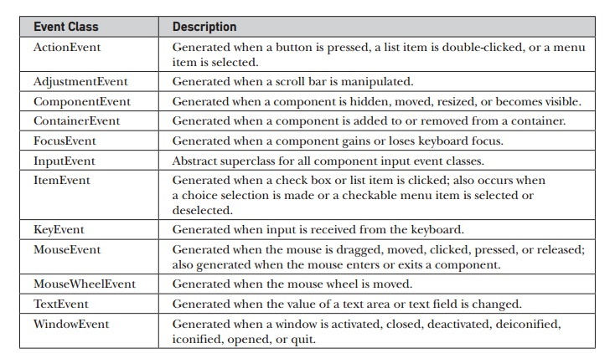

Slide 33
Adapter Class
An adapter class provides an empty implementation of all methods in an event listener interface.
Adapter classes are useful when you want to receive and process only some of the events that are handled by a particular event listener interface.

Slide 34
Adapter Class : Different Classes
ComponentAdapter
ContainerAdapter
FocusAdapter
KeyAdapter
MouseAdapter
MouseMotionAdapter
WindowAdapter
ComponentListener ContainerListener FocusListener KeyListener MouseListener MouseMotionListener WindowListener

Slide 35
Inner Class
Inner class is class which defined in another class.
In inner classes, the Adapter class will defined in same class.
No need of passing reference of object as it is in same scope.
Ex.

Slide 36
Anonymous Inner Class
An anonymous inner class is one that is not assigned a name.

Slide 37
Event Listeners Interfaces
Event Delegation Model has two parts: Sources and Listeners.
When event generated, then event source invoked appropriate method defined by interface.

Slide 38
Action Listener Interface
Defines one method to receive action events.
void actionPerformed(ActionEvent ae)

Slide 39
ComponentListener Interface
Defines four methods to recognize when a component is
hidden, moved, resized, or shown.
void componentResized(ComponentEvent ce)
void componentMoved(ComponentEvent ce)
void componentShown(ComponentEvent ce)
void componentHidden(ComponentEvent ce)

Slide 40
ContainerListener Interface
Defines two methods to recognize when a component is
added to or removed from a container.
void componentAdded(ContainerEvent ce)
void componentRemoved(ContainerEvent ce)

Slide 41
FocusListener Interface
Defines two methods to recognize when a component
gains or loses keyboard focus.
void focusGained(FocusEvent fe)
void focusLost(FocusEvent fe)

Slide 42
ItemListener Interface
Defines one method to recognize when the state of an
item changes.
void itemStateChanged(ItemEvent ie)

Slide 43
KeyListener Interface
Defines three methods to recognize when a key is
pressed, released, or typed.
void keyPressed(KeyEvent ke)
void keyReleased(KeyEvent ke)
void keyTyped(KeyEvent ke)

Slide 44
MouseListener Interface
Defines five methods to recognize when the mouse is clicked, enters a component, exits a component, is pressed, or is released.
void mouseClicked(MouseEvent me)
void mouseEntered(MouseEvent me)
void mouseExited(MouseEvent me)
void mousePressed(MouseEvent me)
void mouseReleased(MouseEvent me)

Slide 45
MouseMotionListener Interface
Defines two methods to recognize when the mouse is
dragged or moved.
void mouseDragged(MouseEvent me)
void mouseMoved(MouseEvent me)

Slide 46
TextListener Interface
Defines one method to recognize when a text value
changes.
void textValueChanged(TextEvent te)

Slide 47
WindowFocusListener Interface
Defines two methods to recognize when a window gains
or loses input focus
void windowGainedFocus(WindowEvent we)
void windowLostFocus(WindowEvent we)

Slide 48
WindowListener Interface
Defines seven methods to recognize:
void windowActivated(WindowEvent we)
void windowClosed(WindowEvent we)
void windowClosing(WindowEvent we)
void windowDeactivated(WindowEvent we)
void windowDeiconified(WindowEvent we)
void windowIconified(WindowEvent we)
void windowOpened(WindowEvent we)

Slide 49
